Slide 1

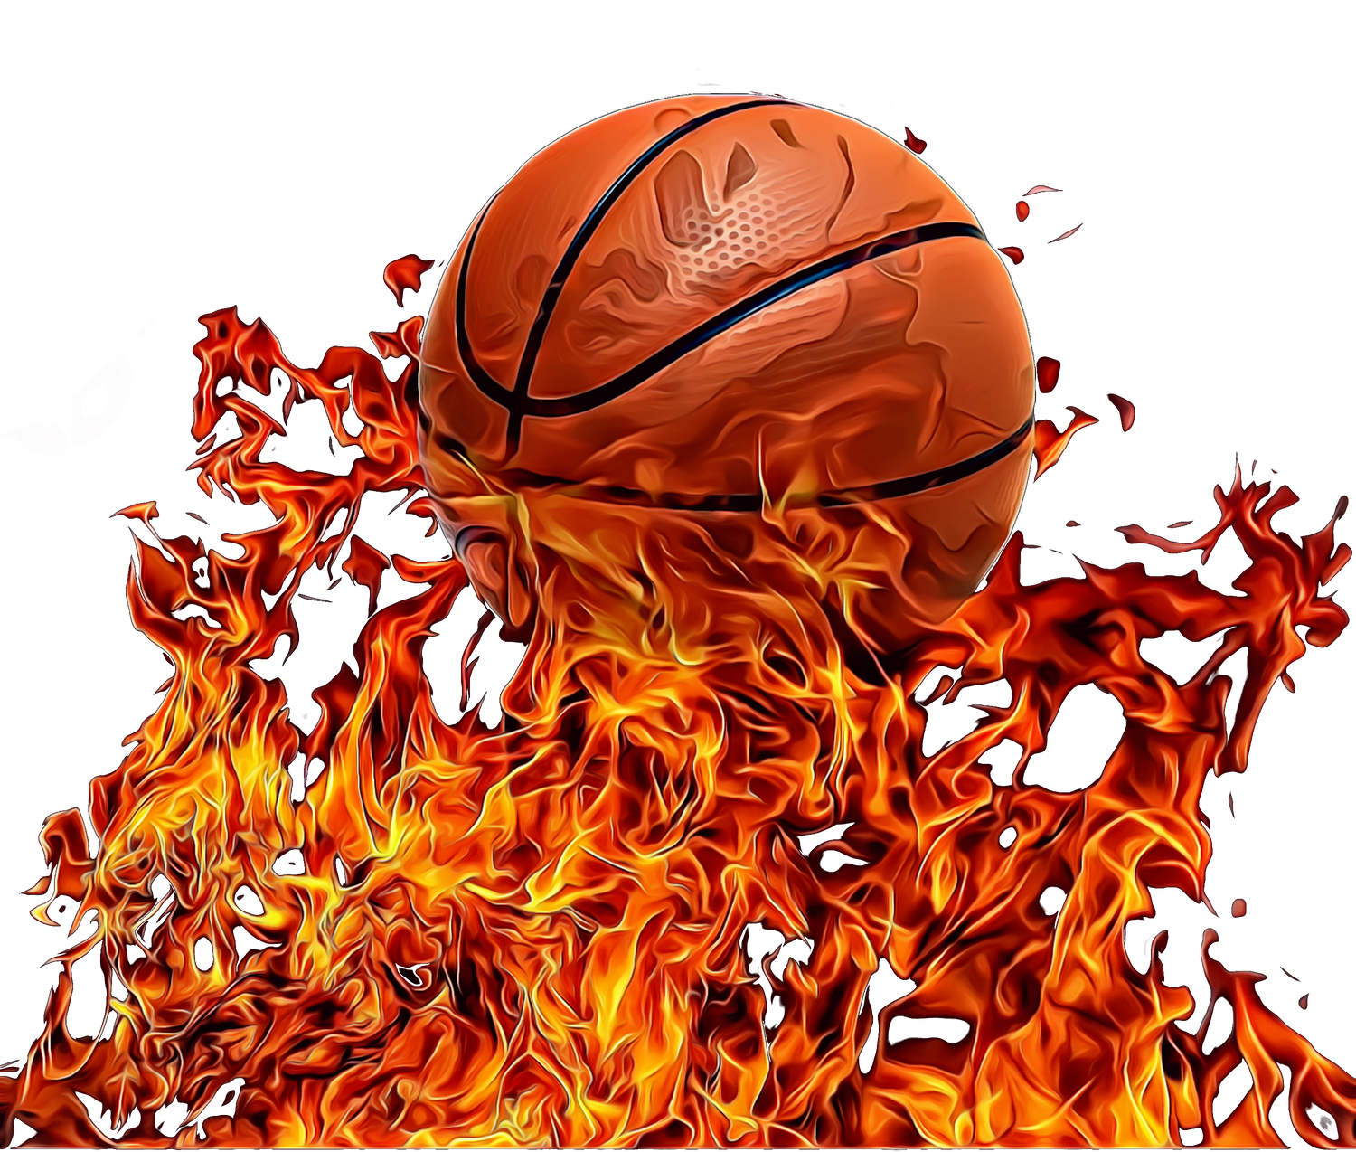

FASTBREAK SPORTS
Notes:
Good afternoon, everyone. Let’s talk basketball—a sport that’s not just about hoops and scoring points but also about teamwork, growth, and chasing dreams. Today, I’m here to share the stories behind three incredible brands that are making waves in the basketball community and how we can take their efforts to the next level with an exciting new campaign.
Before we dive into the Champions of Tomorrow campaign, let’s get to know the brands that are the heart of this initiative.

Slide 2


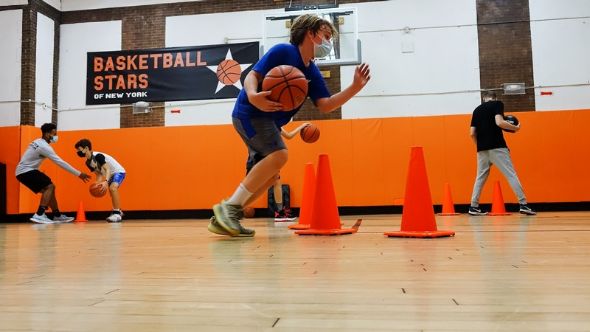
BASKETBALL STARS
MISSION
Building character, teamwork, and accountability through positive support and focused basketball training.
Notes:
Kicking things off with Basketball Stars. Positioned as a premier platform, it helps basketball players at every skill level elevate their game to the next one. Through skill development, advanced training, and a strong sense of community, Basketball Stars connects players, coaches, and fans who share a passion for the sport.

Slide 3

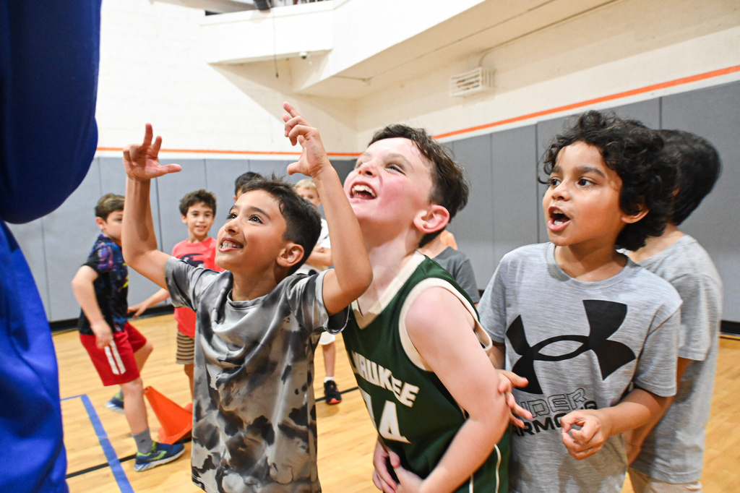
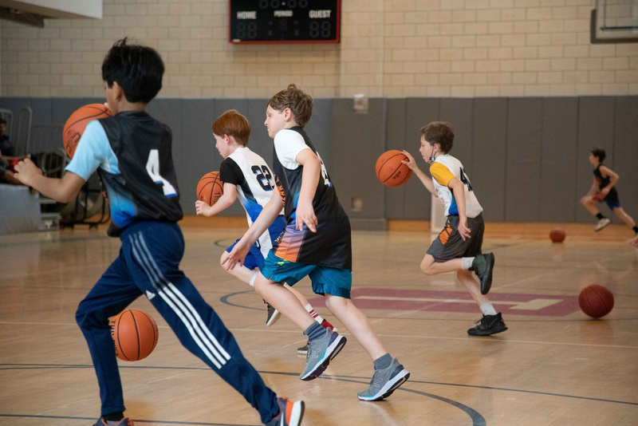
FASTBREAK KIDS
MISSION
Guiding children to master basic basketball skills while encouraging active play and building self-confidence. Providing a positive, engaging atmosphere that sparks a passion for the sport.
Notes:
Next, we have Fast Break Kids, which focuses on the youngest athletes. They offer multi-sport and recreational activities for kids in the Tri-State Area, introducing them to the fundamentals of sports in a way that’s fun and engaging. The brand builds not just athletic skills but also confidence, teamwork, and a love for staying active.

Slide 4

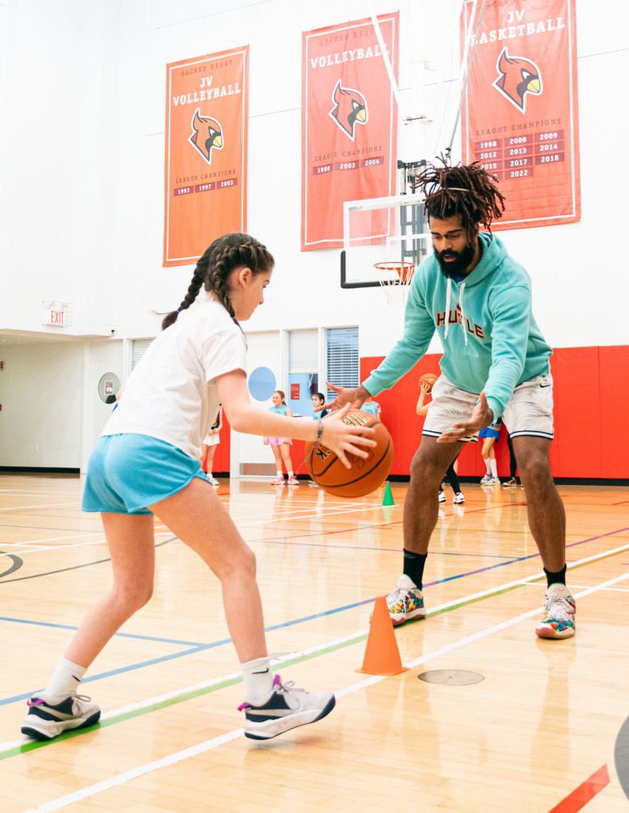
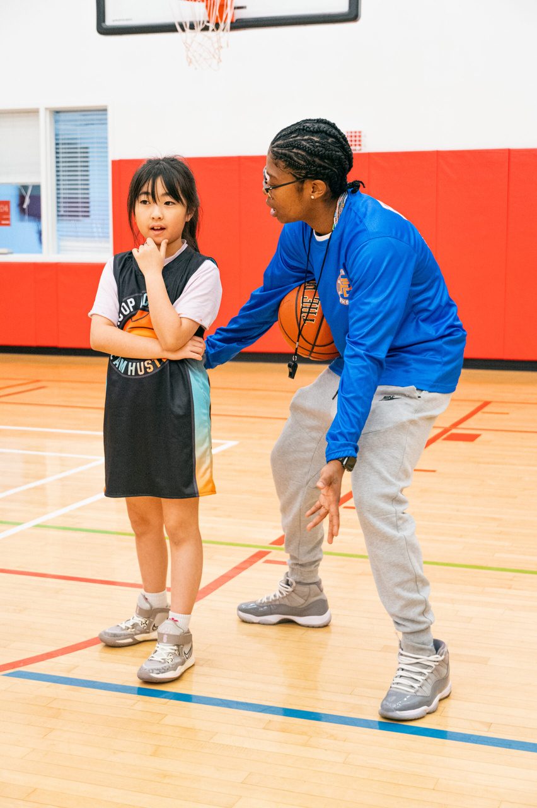
TEAM HUSTLE
MISSION
Empowering young female athletes to grow through basketball training and competitive play, while building discipline, teamwork, and sportsmanship in a supportive environment.
Notes:
Finally, Team Hustle NYC is all about empowering girls through basketball. It’s more than just a sports program—it’s a platform where young female athletes develop their self-confidence, leadership skills, and athletic potential through rigorous training and competitive play.
Together, these brands are shaping the future of basketball, one dribble at a time.

Slide 6
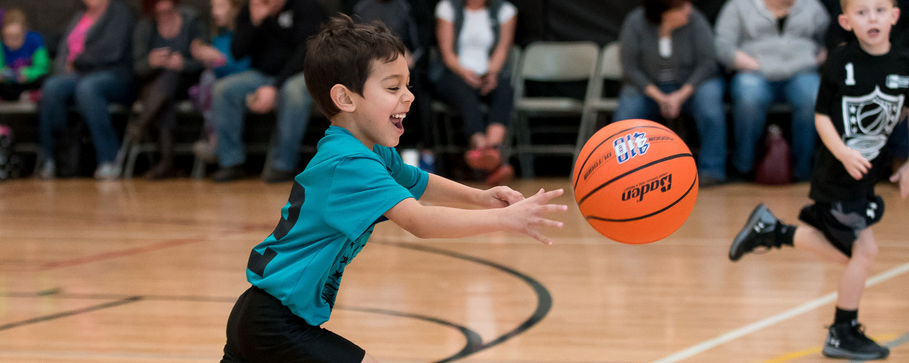
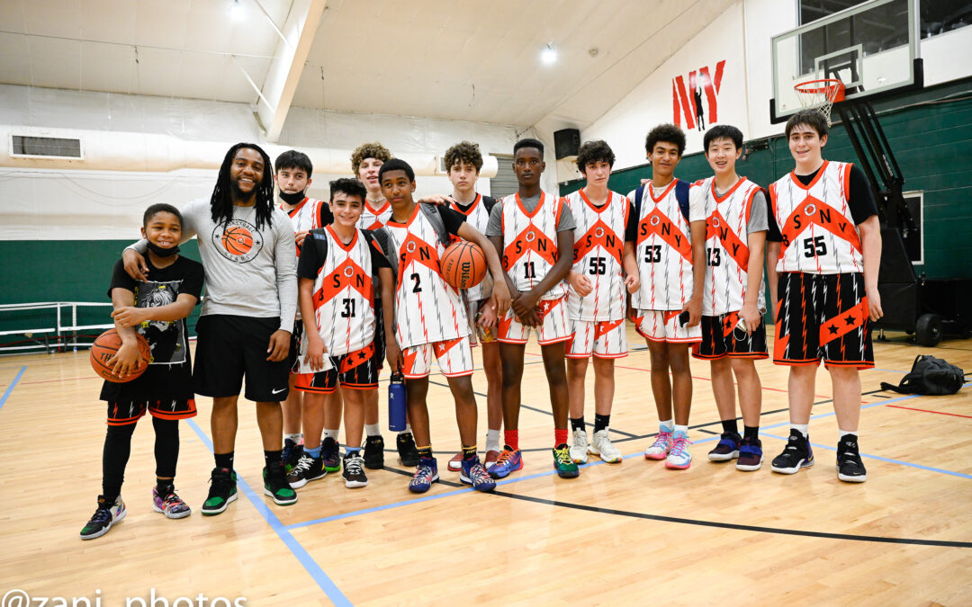
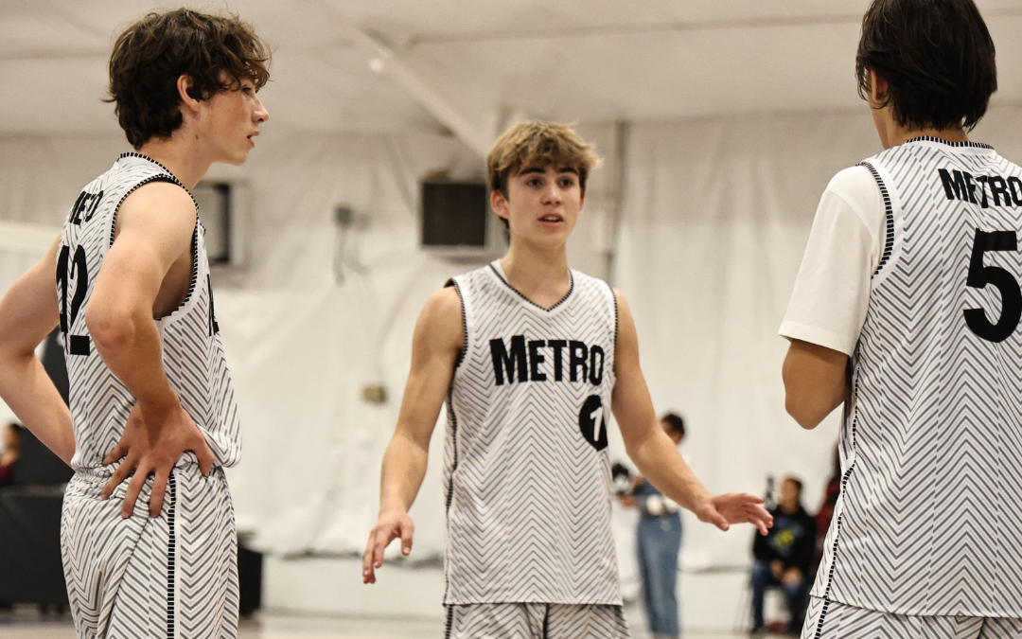
CHAMPIONS OF TOMORROW
Empowering Youth, Building Leaders.
Position Basketball Stars of New York, Fastbreak Kids, and Team Hustle NYC as the leading youth sports programs in the region, emphasizing their commitment to character development, teamwork, and athletic excellence.
Notes:
Thank you, Krishna, for that insightful audit. Now that we’ve seen how these brands are already making an impact, let’s explore how the Champions of Tomorrow campaign can take their efforts to new heights.

Slide 7
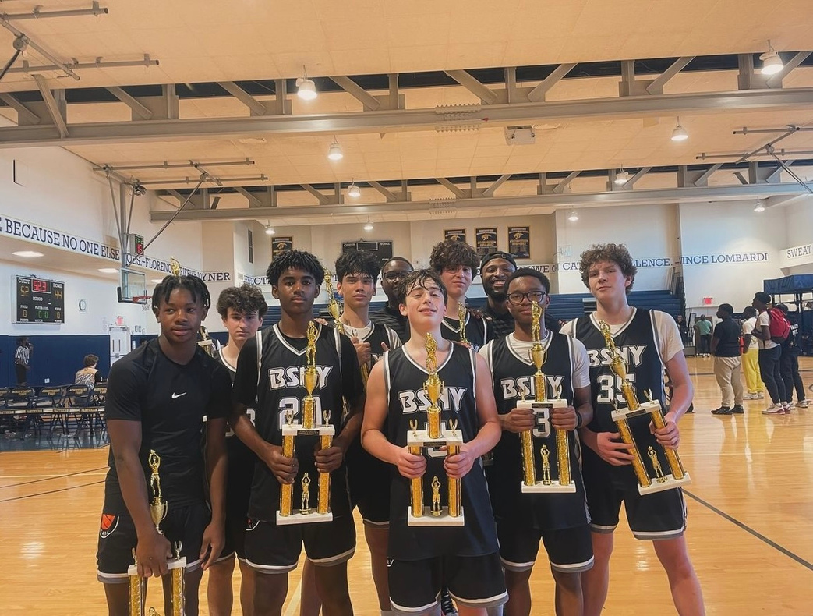
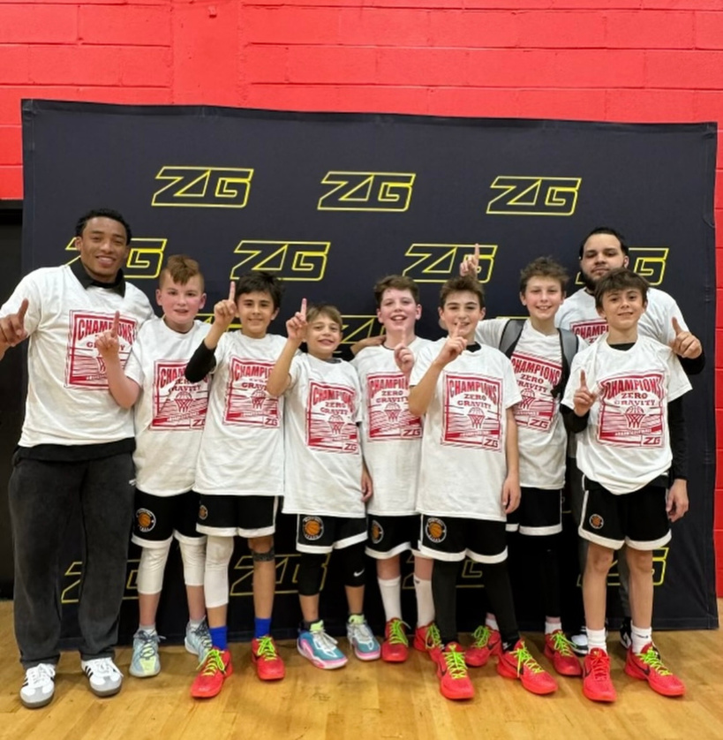
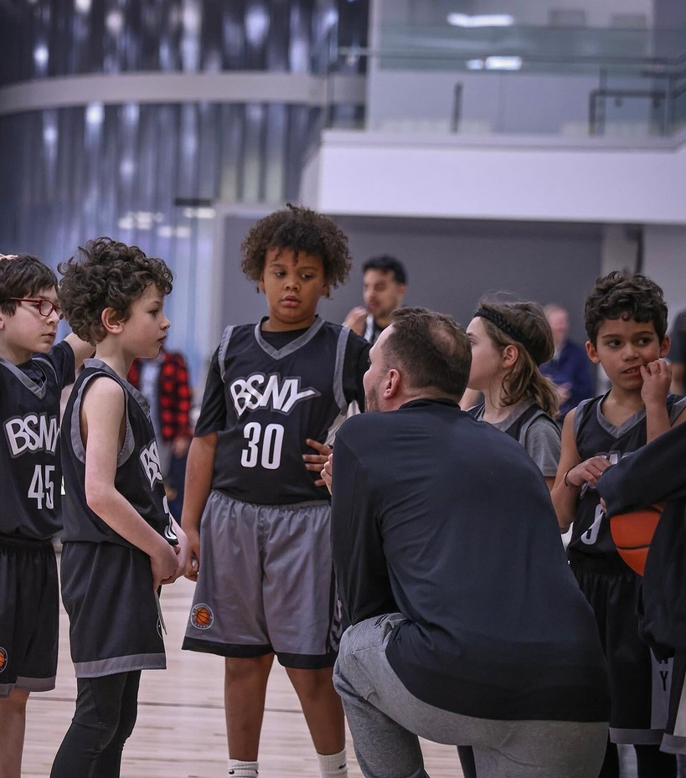
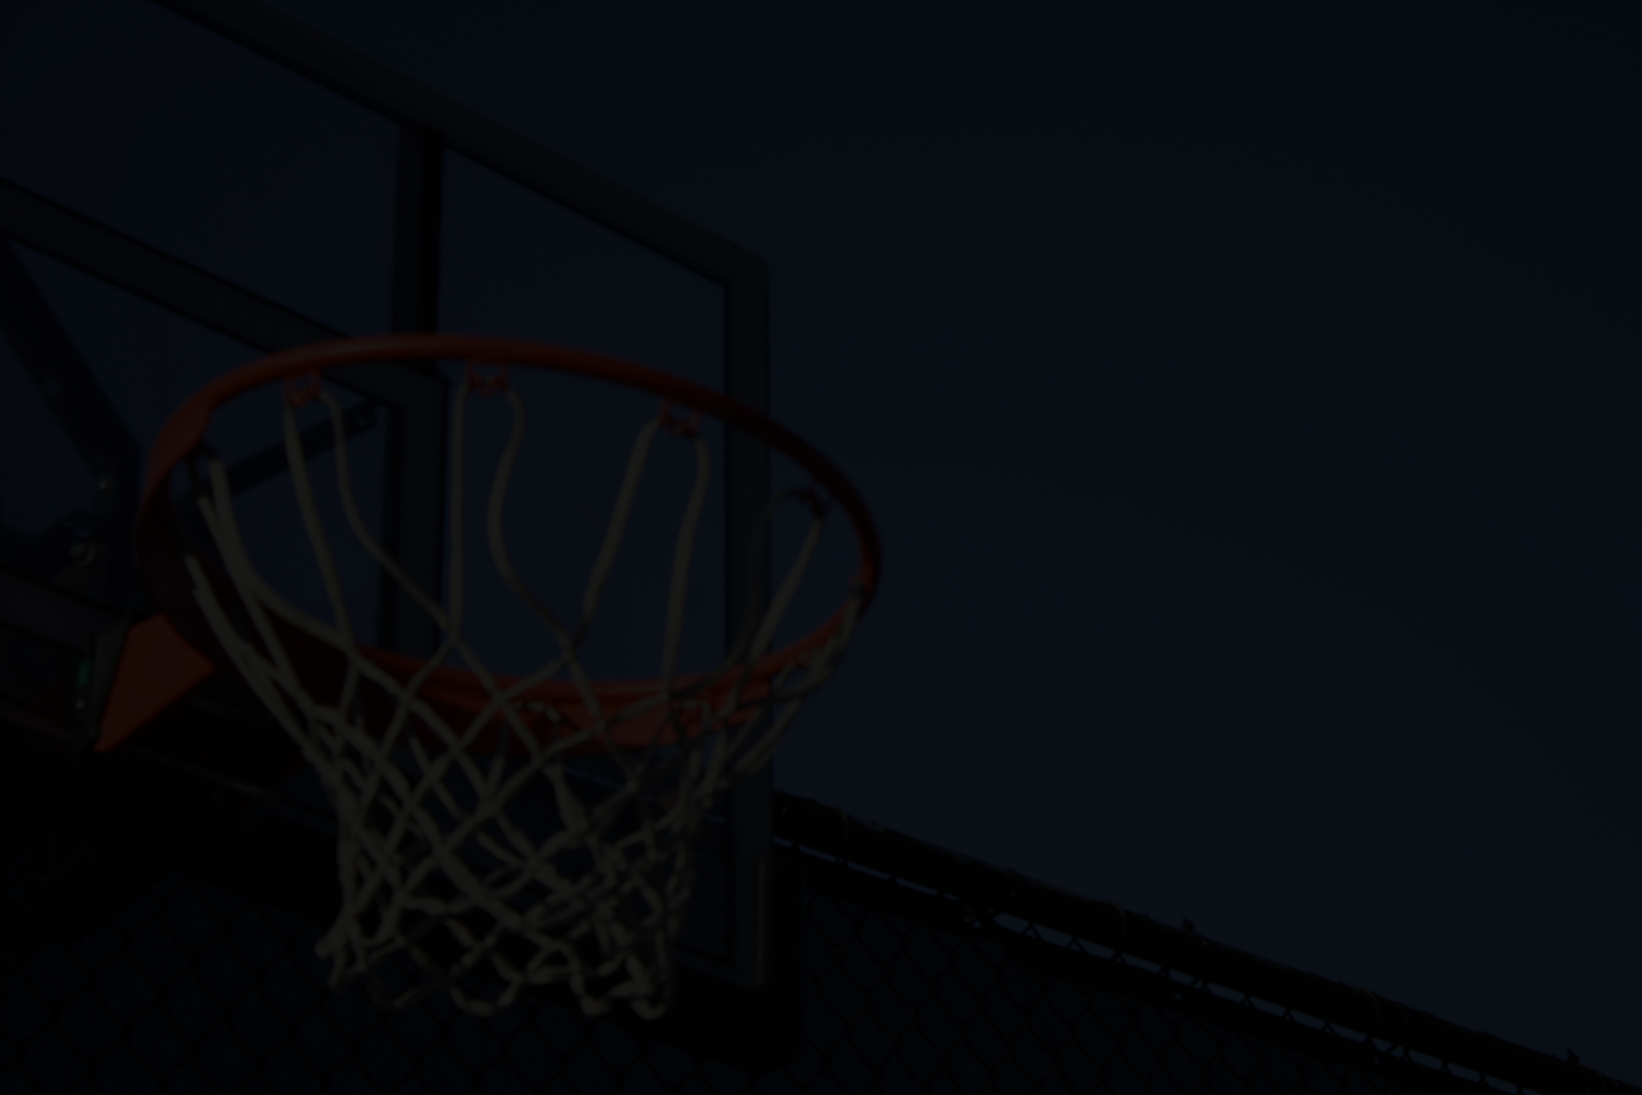
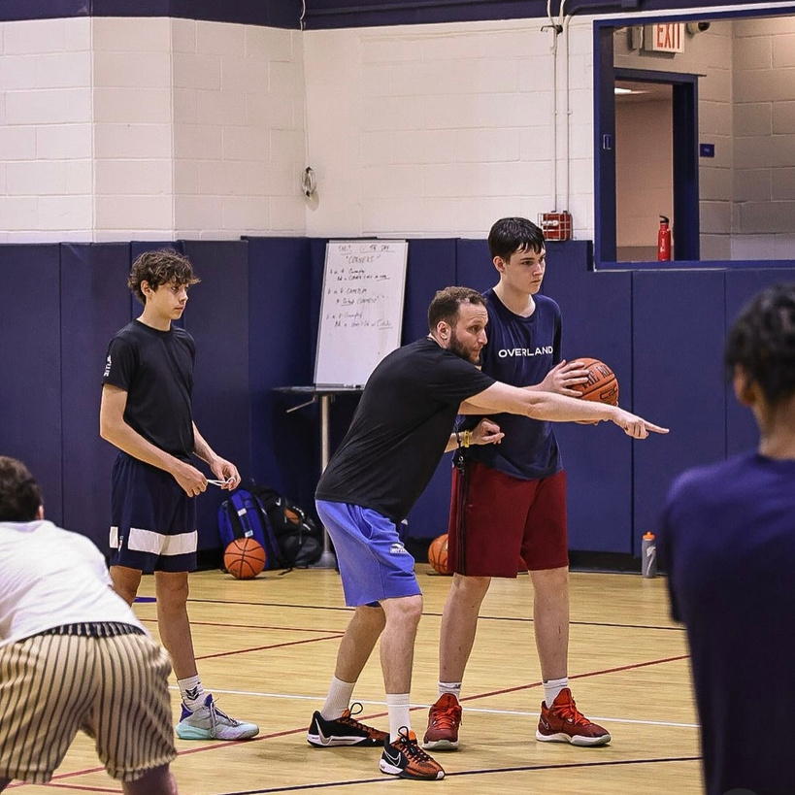
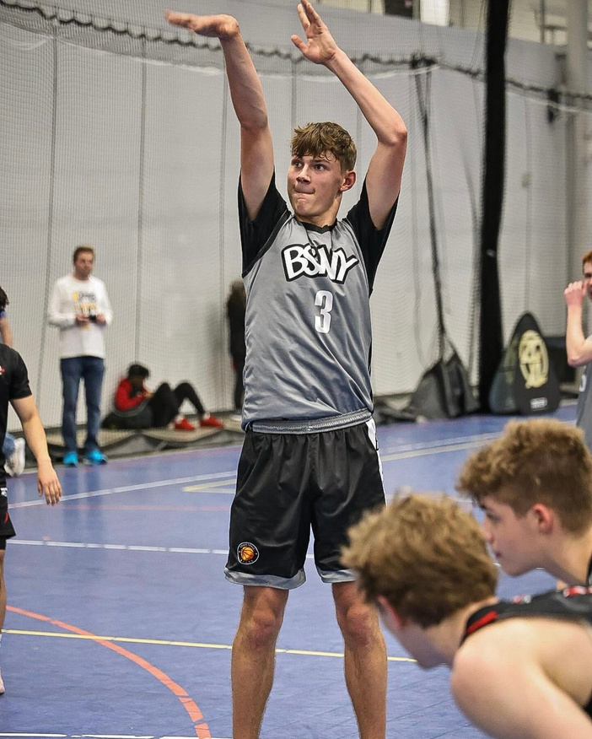
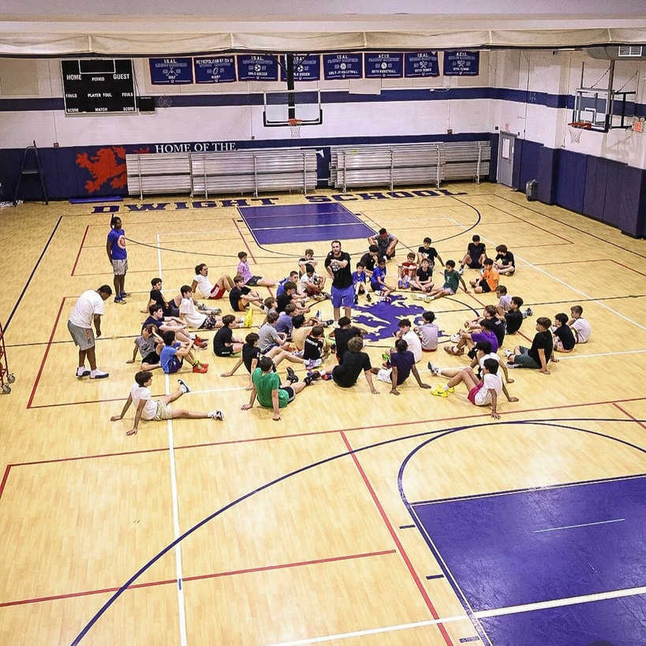
Notes:
The first part of our campaign, Stars in the Making, focuses on young athletes who show exceptional promise. This initiative provides them with opportunities to refine their skills through competitive showcases and skill-building camps, where they’ll also have access to mentorship from professional players and elite coaches. The goal is to help these rising stars shine brighter on the court and reach their full potential. Using platforms like Instagram and YouTube, we’ll showcase their journeys through highlight reels, tutorials, and mini-documentaries, while Facebook will keep parents updated on their progress.

Slide 8
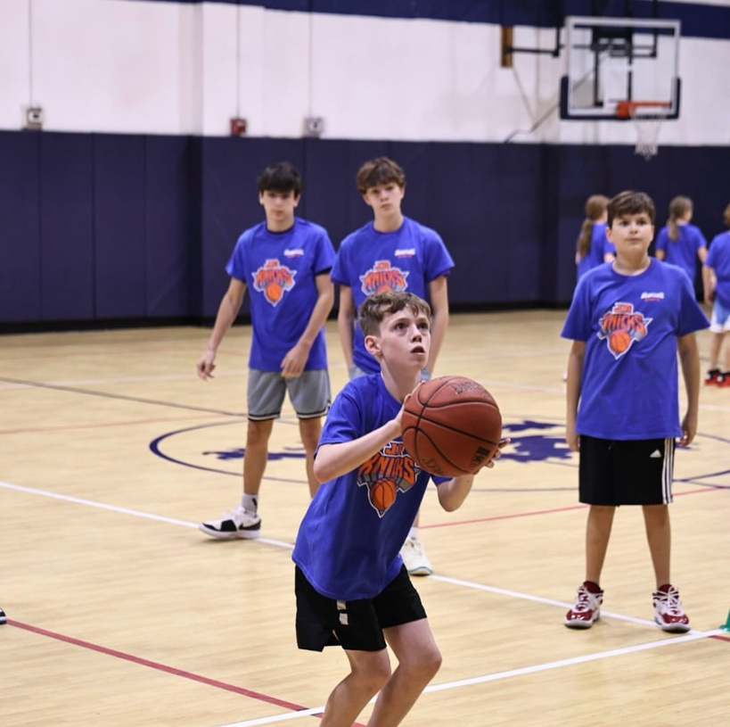
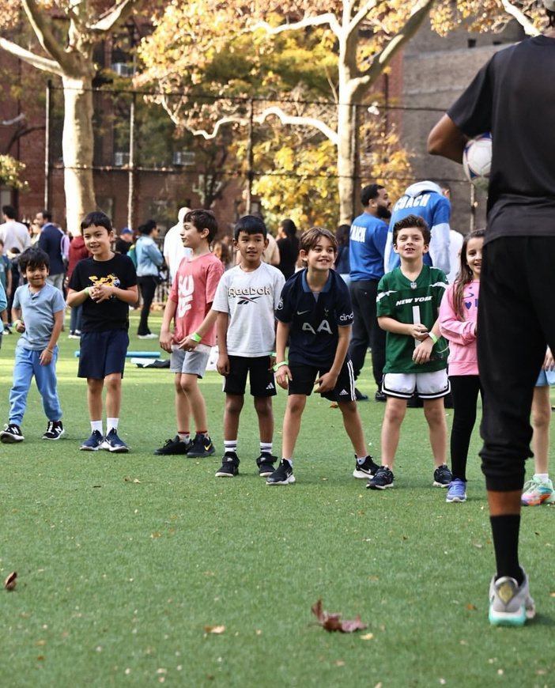
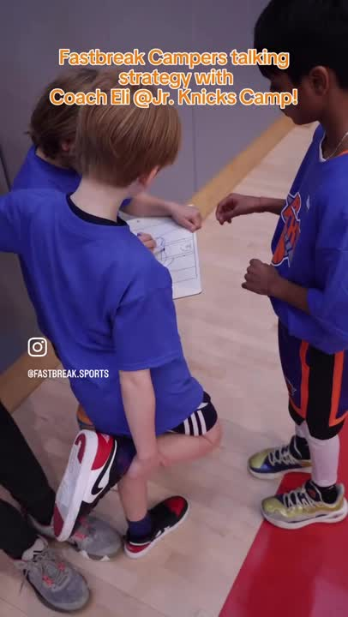
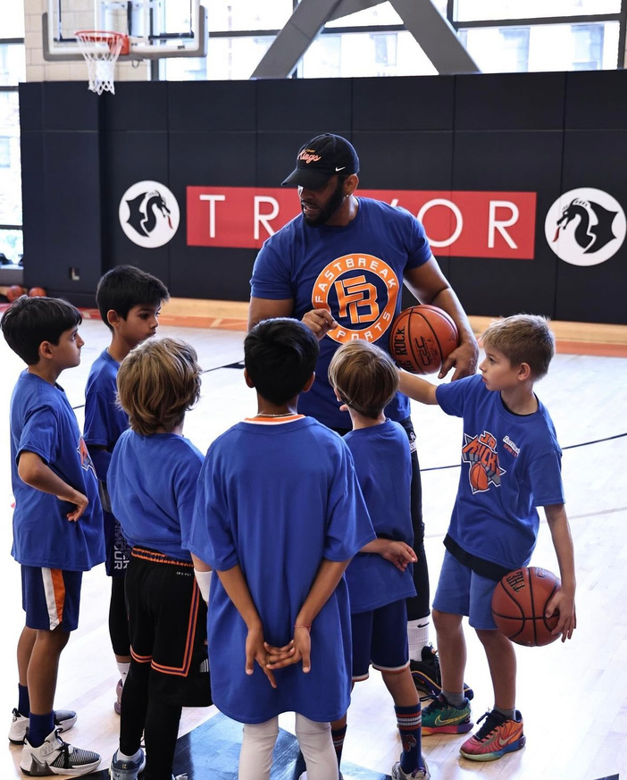
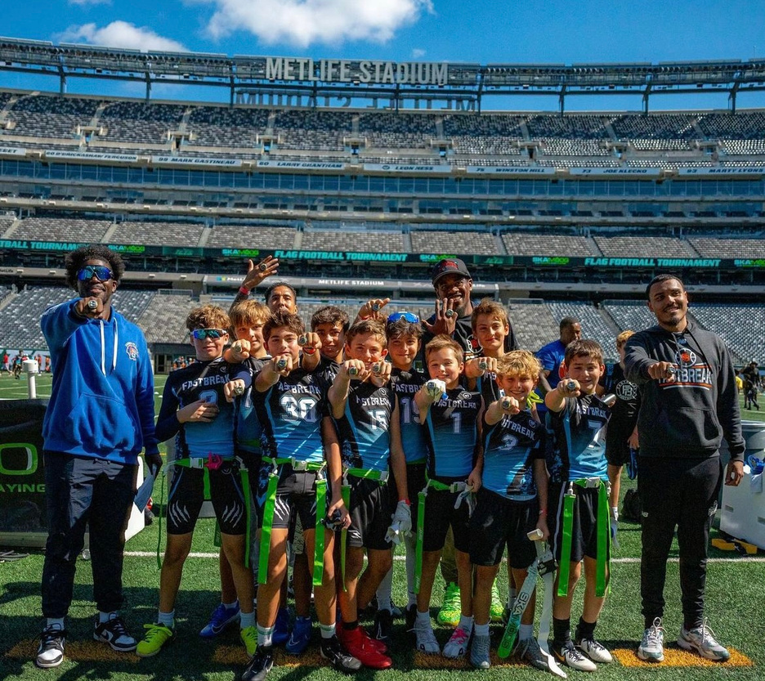
Notes:
Next, we have Little Champs, Big Dreams, which is all about introducing the magic of basketball to kids aged 6-10. This sub-campaign focuses on creating a fun and supportive environment where children can build foundational skills while gaining confidence and a love for the game. Through exciting mini-camps and family-friendly skill challenges, we’ll inspire these young athletes to dream big while starting small. TikTok will be a key platform for sharing playful challenges and fun moments, while Instagram will highlight vibrant, kid-focused visuals to connect with both kids and their families.

Slide 9
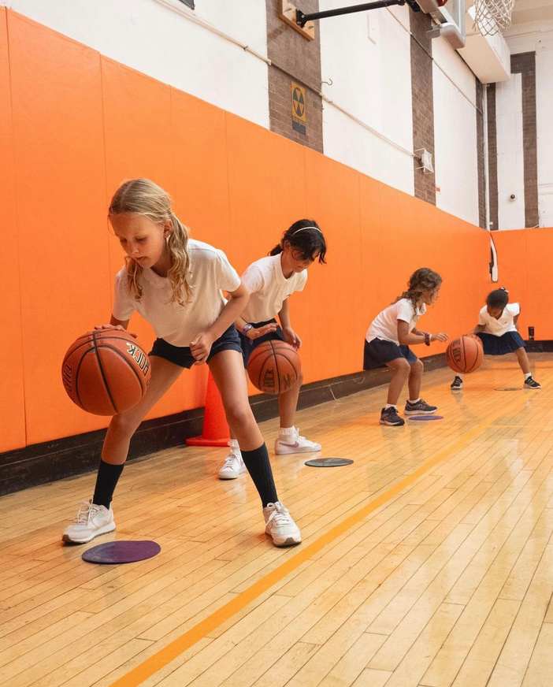
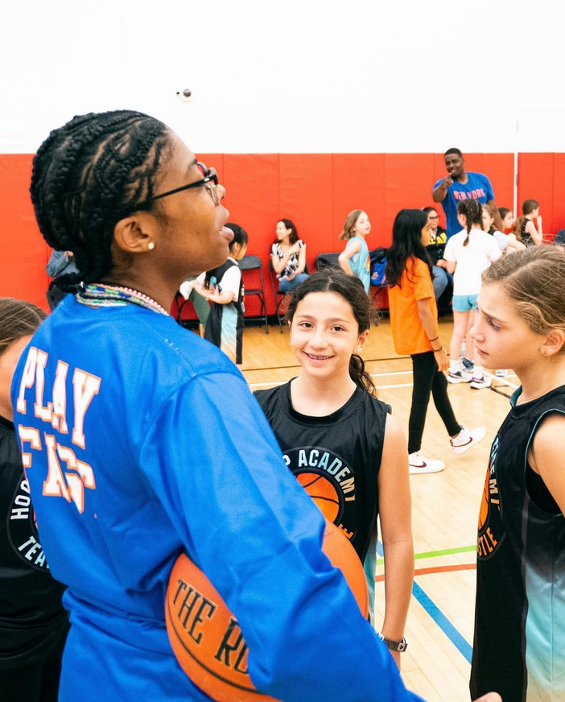
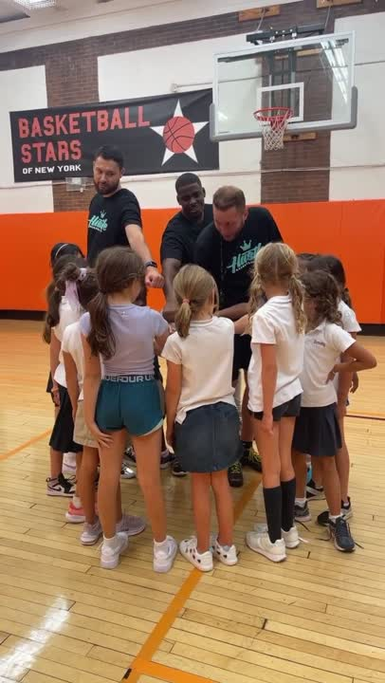
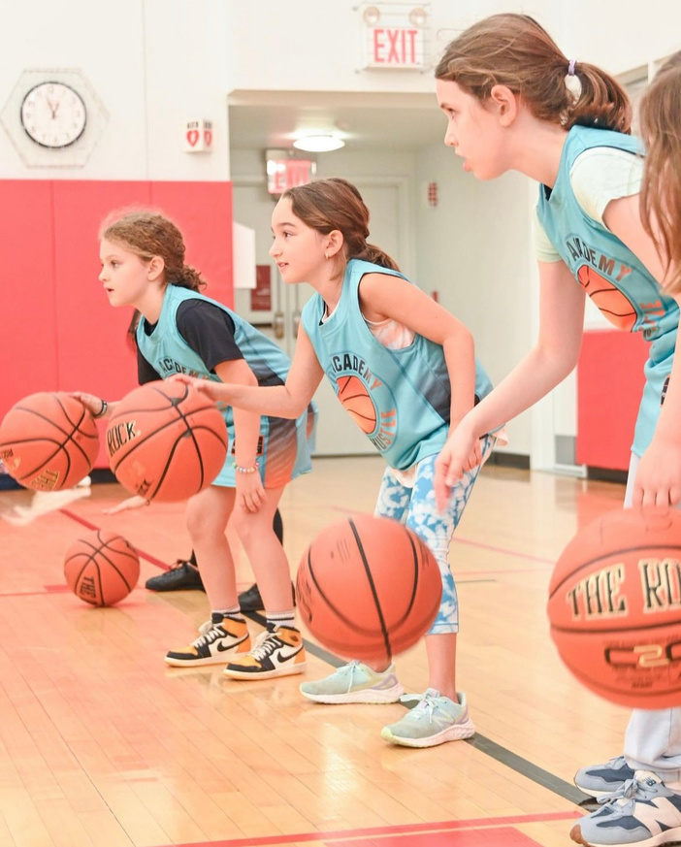
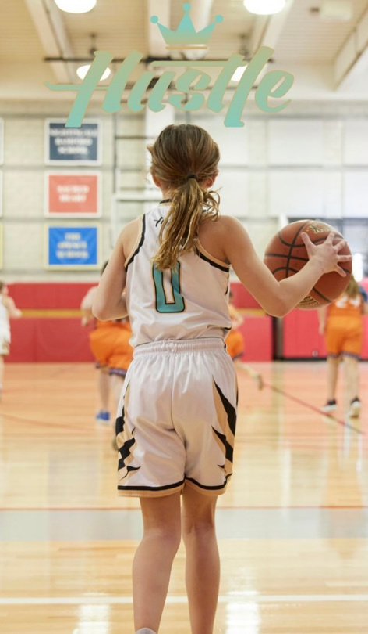
Notes:
Finally, Girls with Grit is dedicated to empowering young female athletes by fostering strength, determination, and teamwork. Through basketball clinics led by accomplished female athletes, we’ll offer mentorship and motivational workshops that show these girls the power of grit and resilience.

Slide 10
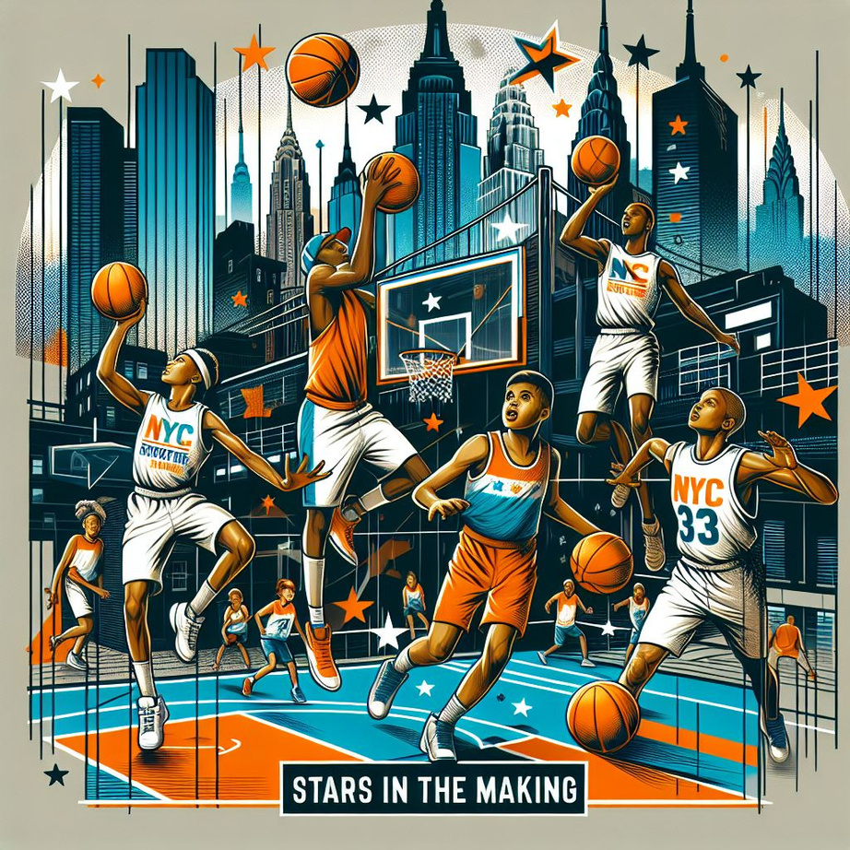
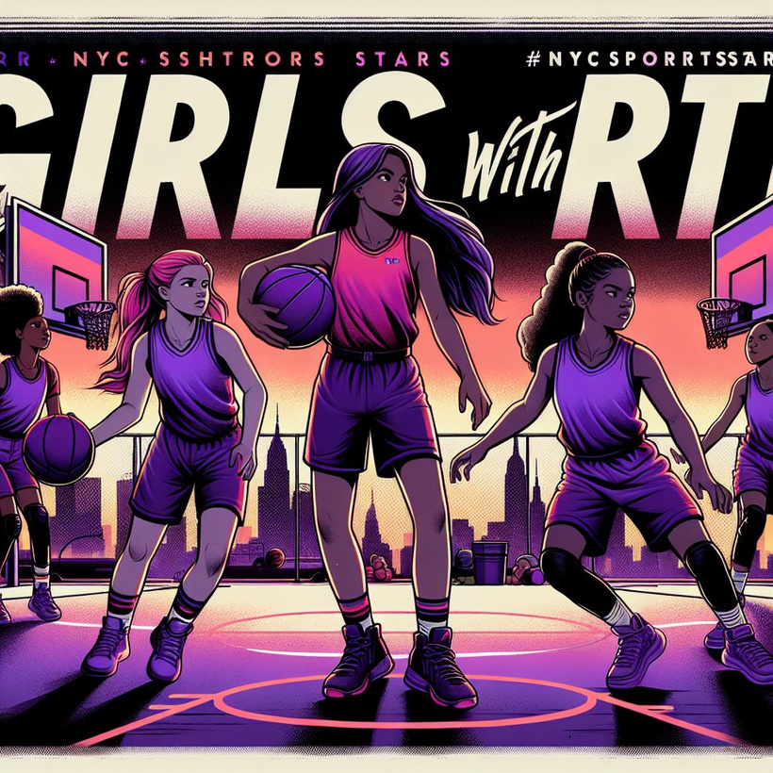

Notes:
This campaign will use Instagram for storytelling, TikTok for dynamic and inspiring clips, and YouTube for in-depth profiles of players as they navigate their basketball journeys.
Together, these sub-campaigns create a cohesive movement under Champions of Tomorrow, each addressing a specific audience while sharing a common mission: to inspire, empower, and nurture the next generation of basketball champions.

Slide 11
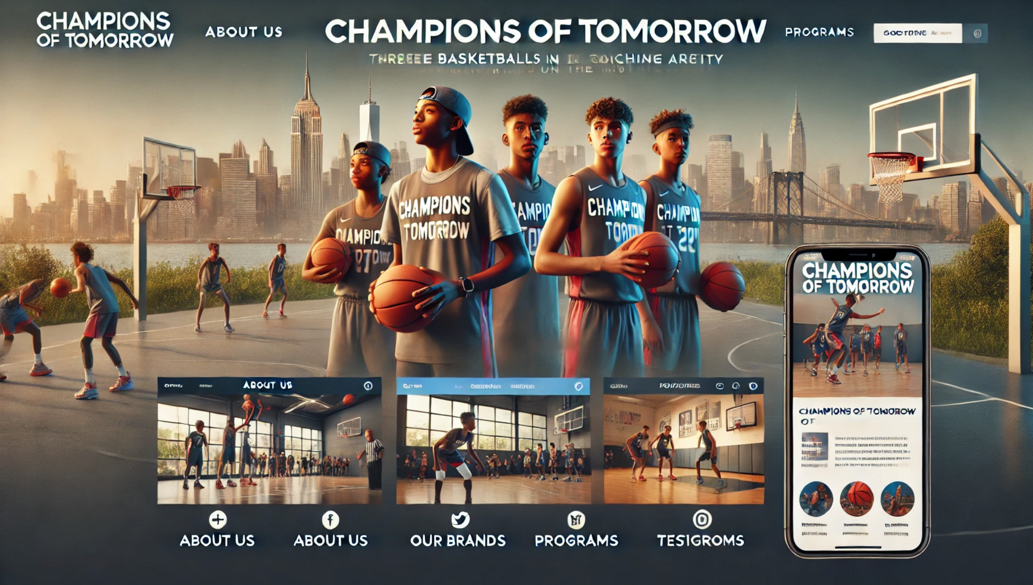
Notes:
To further enhance accessibility and management, we propose launching a unified website and social media handles under the Champions of Tomorrow name. This platform will serve as a centralized hub for updates, event registrations, athlete profiles, and engaging content, ensuring a seamless and user-friendly experience for athletes, parents, and fans alike.
Now, I’ll hand it over to [Sally], who will walk us through the potential revenue growth opportunities this campaign unlocks and the data supporting those insights.

Slide 12

THANK YOU

